Slide 1
Vessel Config - Quick Quote
User Guide
Pilot: US Market
February 2026

Slide 2


User Guide
01
Sales Funnel
02
Configuring a Quick Quote
03
Pricing A Quick Quote
Phase 1: Pilot - US Market
February 2026
04
Customer Proposal
05
Mobile Experience

Slide 3
Sales Funnel
Mercury is supporting Repower with full-funnel approach to support engagement and conversion
Media
Target consumers interested in Mercury and those out of warranty or coming up on their warranty expiration
Serve high, mid, and portable repower messaging
Drive traffic to the Repower Request a Quote section on the Mercury website
AWARENESS
Content
Create emotional and rational content across various owned channels
Educate and inspire on social media and Dockline blog
INTERESTED
Lead Capture & Generation
Motivate consumers to complete the Request a Quote feature to drive leads to the dealership
Nurture consumers interested in Repower through email series and monthly content
Quick Quote Tool
ENGAGED
Dealer Repower Program Assets
Provide signage, POP and assets to showcase repowering options on local dealer channels
Send email and direct mail campaigns on behalf of dealers to encourage conversions
CONVERSION

Slide 4
















What is Quick Quote
Streamline the initial quoting process all in one tool. Engine, Controls & Rigging, Labor. Enable more quotes and rapid responses to requests
Repower
Repower
You Have a lead
Existing Vessel
Quick Quote
Negotiate & Close
Final verification, Configure, place order
A prospective customer has asked for a repower quote:
Email/Lead Gen
Phone Call
Boat Show/Walk In
Some Key Questions to ask:
What type of boat
What's the existing engine (Make, HP, electronics)
Repower goals
What’s the budget
Use the information supplied to make selections in Quick quote tool
At launch packages preselected for:
Center Consoles
Freshwater Fishing boats
Single Engine 175-425HP outboards
Present initial proposal
/options
Upsell, add-ons, other service, etc.
Consider Mercury Product Protection
Financing
Before a final contract is signed, closer inspection should be done by a technician:
Measure lengths and determine hardware & fittings for cables, harnesses, hoses, etc.
Inspect condition of components that may be reused or that should be replace.
Determine prop selection/use prop selector, demo program
Use vessel configurator to build and place order, and/or on hand inventory that will used for job

Slide 5
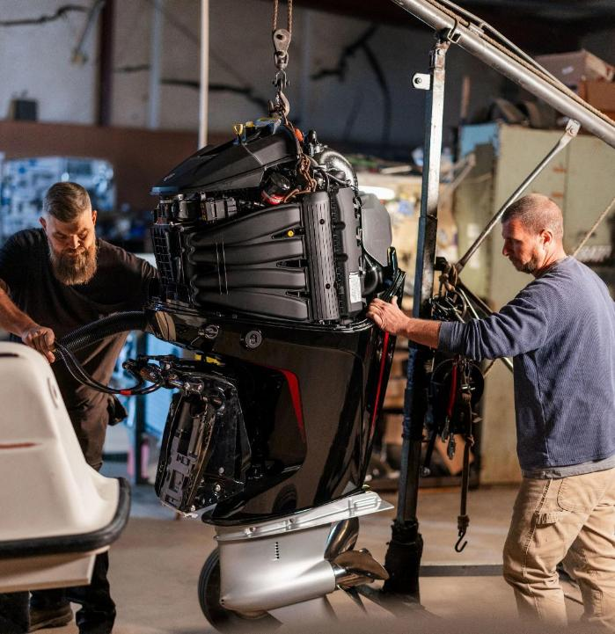
Quick Quote
02
Configuration

Slide 6
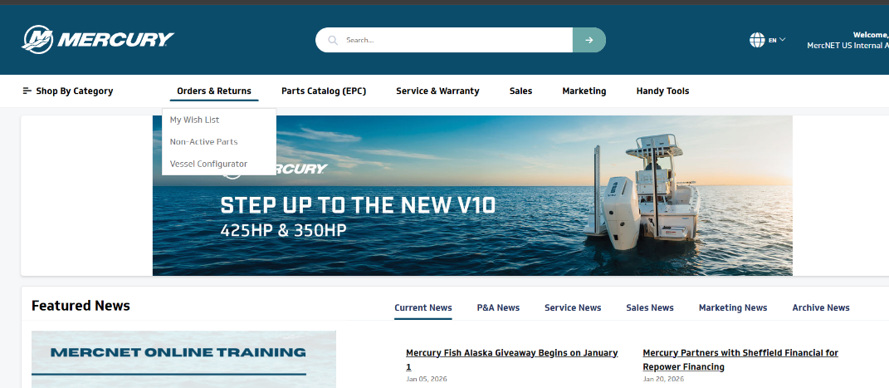


Navigation
From MercNET Vessel Configurator is found in the Orders and Returns menu
Vessel Config Home
    Gas Engines: Complete Controls and Rigging BOM generation with Add to MercNET cart
    Quick Quote: Complete Sales Quote for Outboard Repower. (engine, C&R, Labor).
      Pilot 175-425 Single Engine Application
      No Add cart

Slide 7
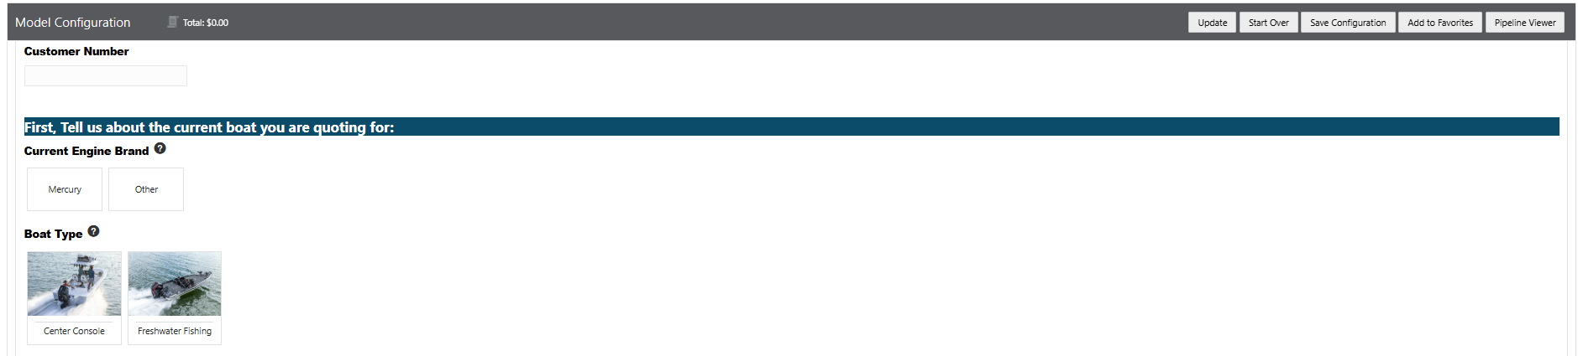
Configuration Tab
1) Begin by selecting the Boat type and existing engine make to help define controls and rigging packages that have been created to suite a typical application and what is required
Click on icons for additional refence aides, links.
?

Slide 8
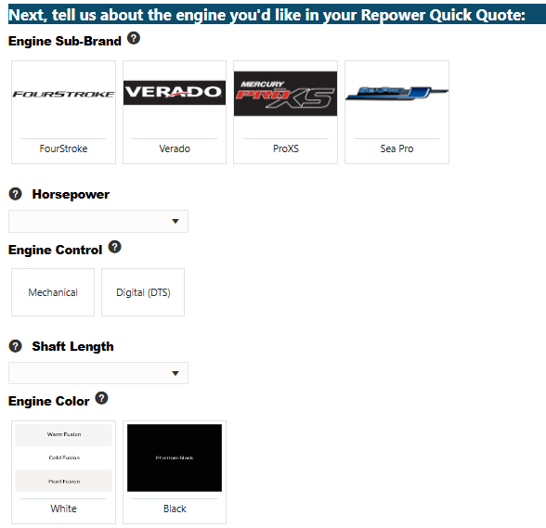
Configuration Tab
Mercury Engine Selection
Proceeding with fields top to bottom will filter subsequent options based on the available models
In some cases options may exist while in other scenarios a selection will have already been made:
  E.g. If Verado Sub Brand is selected only Digital Throttle and Shift (DTS) models are available
All fields must be selected
You may revise selections alert icon will identify where selections are invalid with updated engine choice requiring changes
Where available the option to upgrade to white is consistent between Cold, Warm and Pearl Fusion white. For quote pricing cold white engines are selected. The 3 colors allow for cowling to be complementary to existing boat / gelcoat shade
!
?

Slide 9
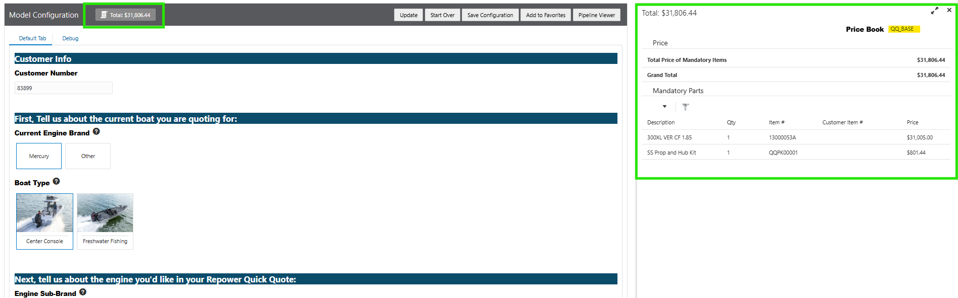
Configuration Tab
Mercury Engine Selection
Once all engine fields have been made, you’ll see $ value populate the bill of material window that can be expanded on the right-side pane.
  Dealer Base Prices will display. At this stage, no discounts are being applied
?
Stainless Steel Propeller and hub kit included with engine selection
Unless repowering with the same engine a new prop is recommended with repower. Prop selector or the demo prop program can assist with dialing in the exact right prop when the deal is closed and parts are ready to be ordered

Slide 10

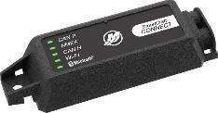
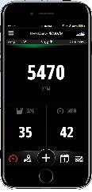
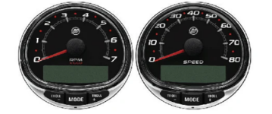
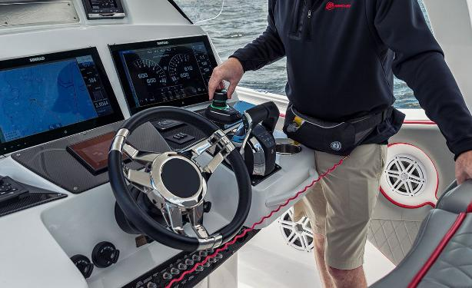

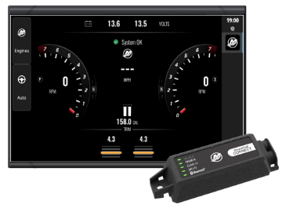
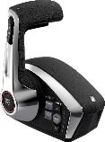

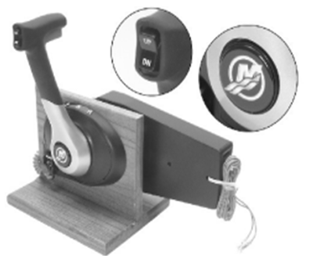
Configuration Tab
Remote Control Packages
Steering Packages
Instrumentation Packages
All the necessary helm and rigging hardware is packaged together. Includes helm controls, key switches, and required harnesses, cables, junction boxes, etc..
Options available will mirror Mechanical or DTS engine selection.
  Console mount for center console boat, panel mount for freshwater fishing boat
Hydraulic Power Steering or Electric Steering packages from Mercury are Options
“No, Keep current steering” option is available if re-using existing steering system or a if a third-party option will be used
Varity of Smartcraft options: Mobile, SC1000 gauges, Connect, or Display
▌if the boat being repowered has Mercury power reusing, existing components may be possible*
Notes:
*Warranty.
Technician should inspect to confirm condition and compatibility

Slide 11
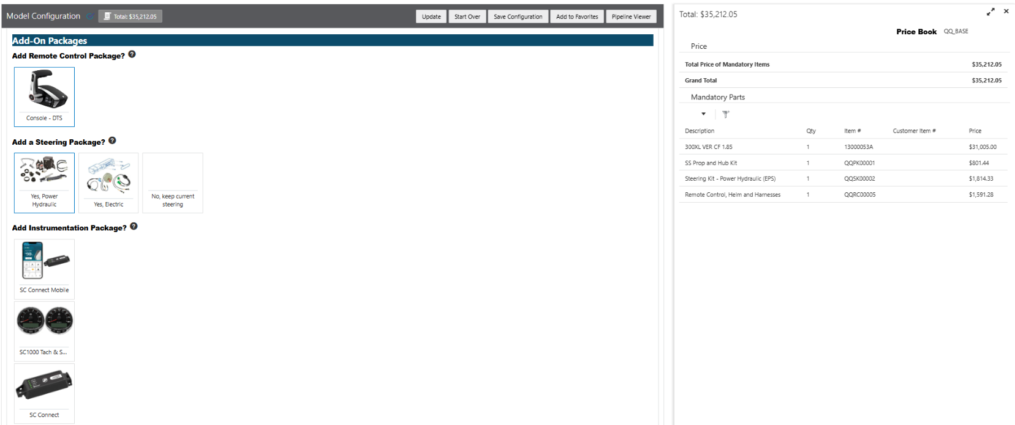
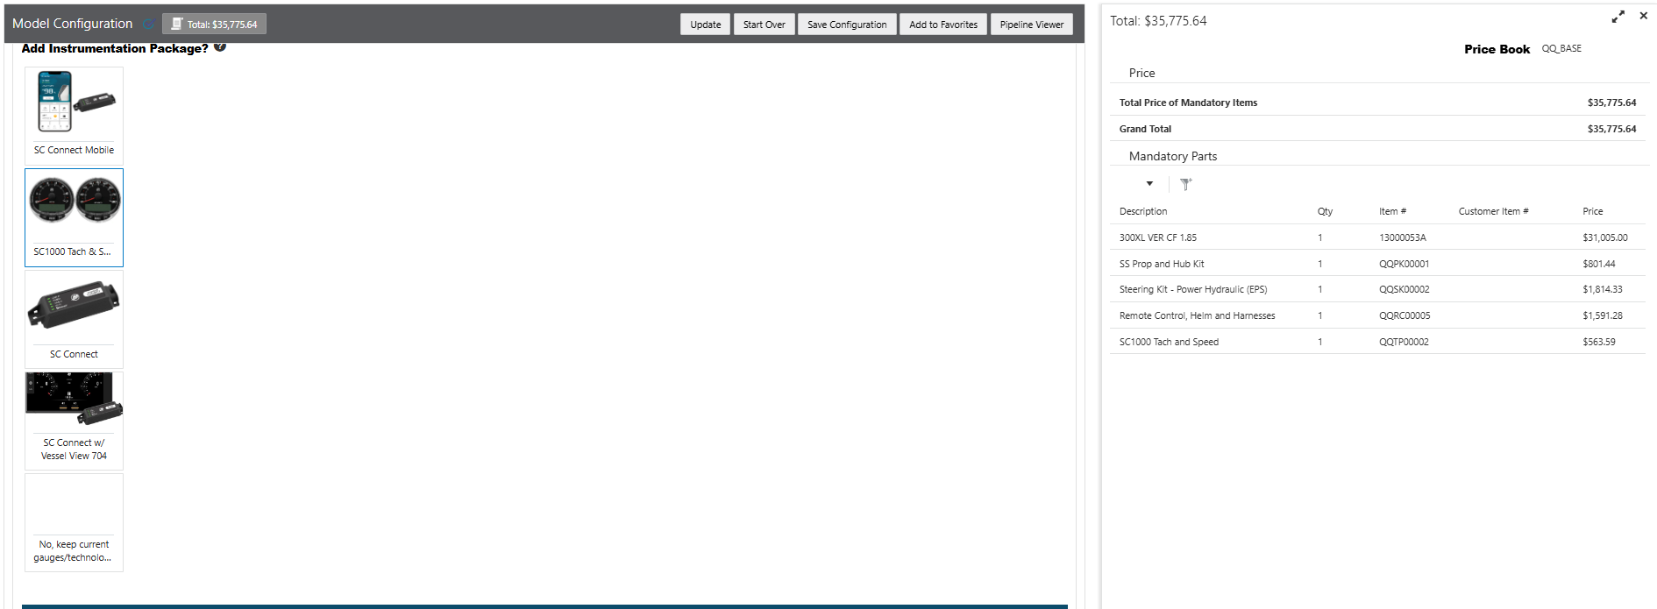
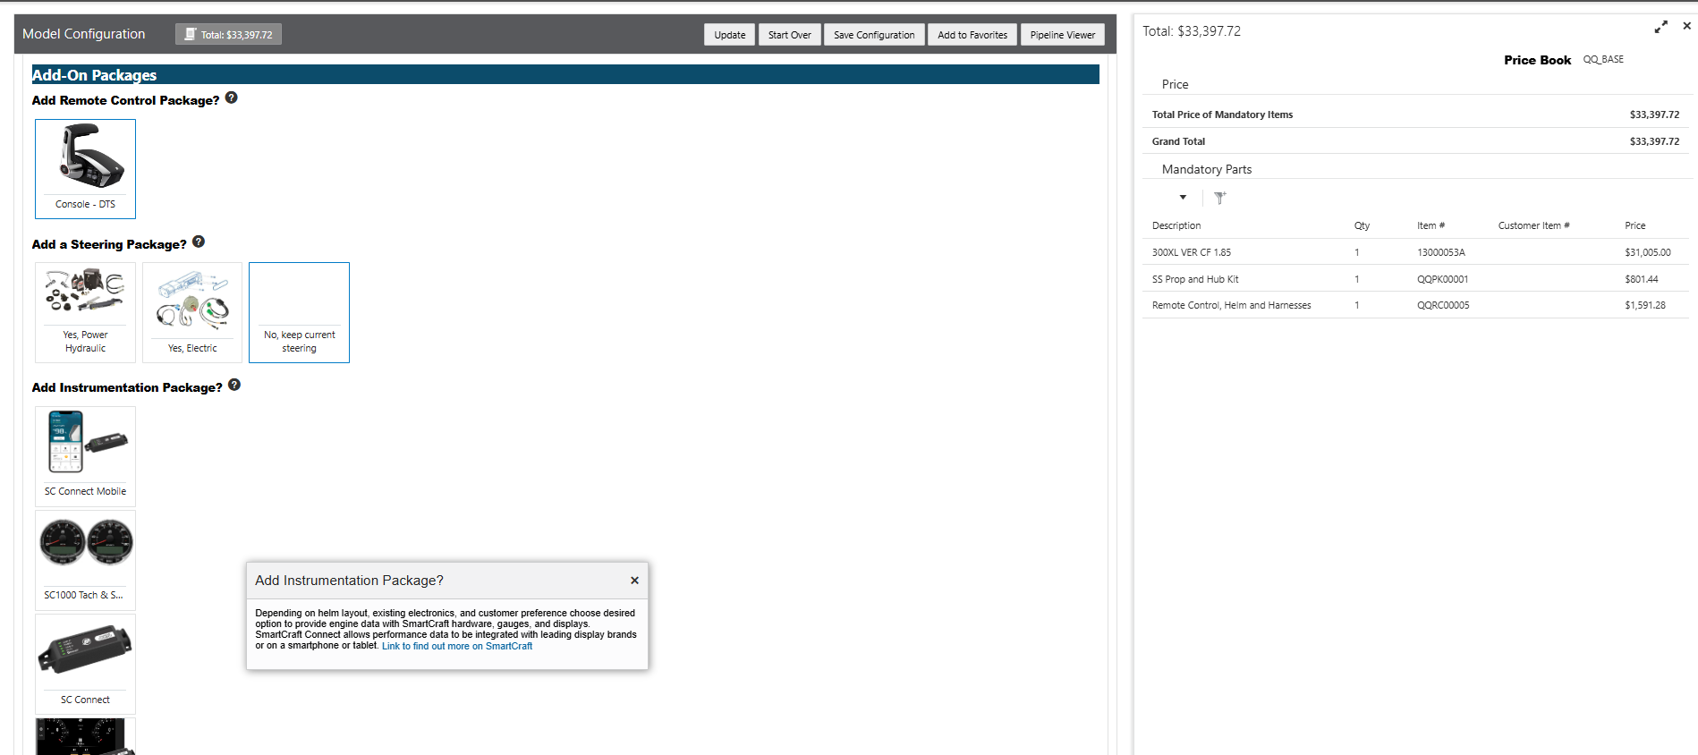
Configuration Tab
As selections are made packages are added
❶ Propeller and hub included with engine selection
❷ Steering Packages
❸ Helm/Remote Control Packages
❹ Instruments (Smartcraft)

Slide 12
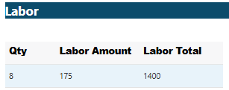
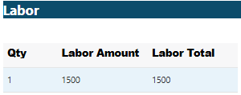
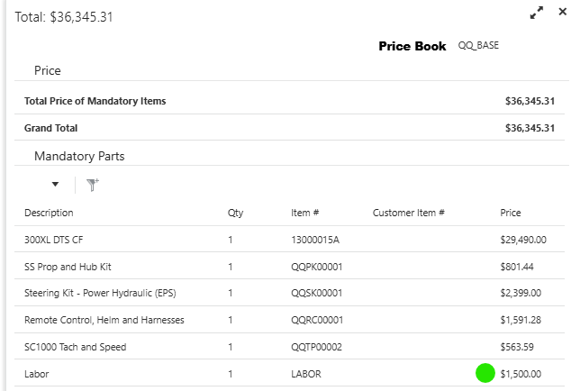
Configuration Tab
Labor Calculator
You may select a Time Estimate and Hourly rate or set a total estimate
Offers users the flexibility to provide a labor estimate consistent with your market, policies, and technicians’ guidance

Slide 13
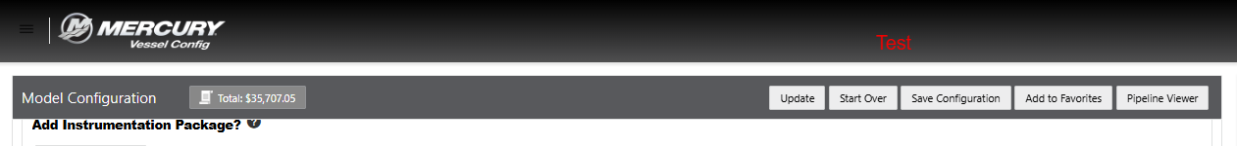
Configuration Tab
▌Once desired packages and labor have been added click Save Configuration to advance to next steps

Slide 14

Quick Quote
03
Pricing

Slide 15
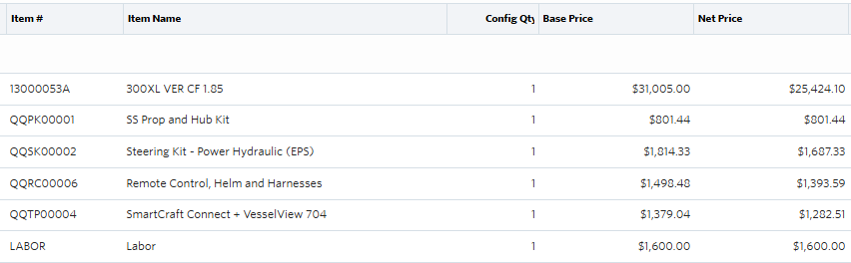
Pricing
Base Price: Published Dealer Base displayed for Engines, Controls & Rigging, and Props.
Net Price: Dealer prices after discounts for Stocking Status, Program level, and elite status are applied per Dealer Sales Program Guide. Includes discounts available when controls, rigging, & props are ordered through vessel config.
*No other Discounts, fees, or charges are calculated in the quick quote Net Price
** Reference the program guide or contact your business development manager for more information regarding your program level
† Only Dealer channel pricing in USD is available at launch in February 2026
Cust Key x Product Line | Type | Sales Program Level | OB STKG | Elite
22-Jan-26 | Outboard Repower
Customer / Product line | Outboard Engines | Controls and Rigging | Props
DealerNoNo | 0% | 0% | 0%
DealerSilverNoNo | -5% | 0% | 0%
DealerGoldNoNo | -8% | 0% | 0%
DealerPlatinumNoNo | -10% | 0% | 0%
DealerPlatinumNoYes | -10% | 0% | 0%
DealerGoldYesNo | -14% | -5% | 0%
DealerPlatinumYesNo | -18% | -7% | 0%
DealerPlatinumYesYes | -18% | -10% | -10%
Non
Stocking
Stocking
As an example, a non elite platinum stocking dealer: Would see an average discount for all parts of -16% off base
(-18% Engine & -7% for Controls and rigging)

Slide 16
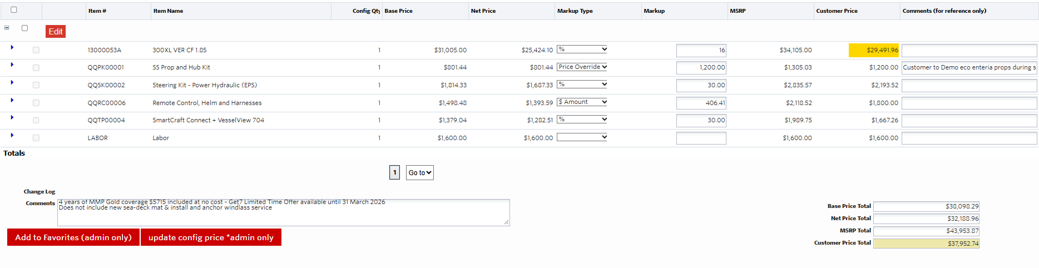

Pricing
Markup Type: $, %, Price override. On the line level you have the option to select a markup type to be applied to your Net Price:
  $: An absolute dollar level added on to Dealer Net Price
  %: percentage of net price added on
  Price Override: Directly enter the price you will off the customer; can be used to round figures
  After Selecting mark up type enter figures into the markup to calculate customer price
    Customer price field will show yellow until quote is saved
    If no markup is selected customer price = MSRP
  Based on markup amount you’ll be able to show a customer price discounted off the published MSRP

Slide 17
Pricing – Markup Example
  For the same example, the customer is receiving a discount of ~14% off MSRP including labor & excluding taxes, fees, or other charges.
  The Dealer can see their potential profitability (excluding what is assumed within labor) is ~$5,760 or 16%

Slide 18

Quick Quote
Proposal

Slide 19
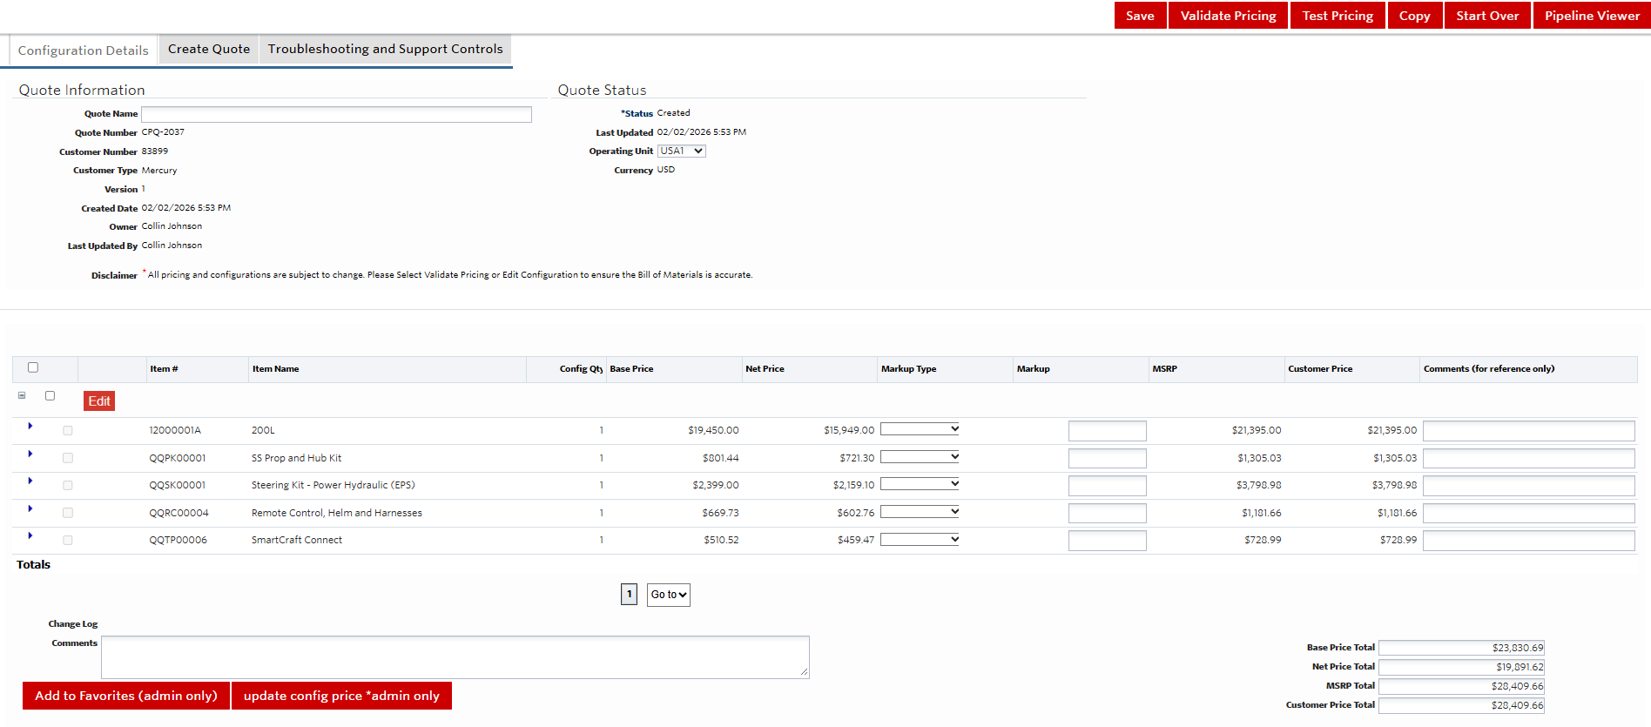


Quick Quote Proposal
▌The item numbers for the controls rigging and prop packages are place holders unique to the quick quote tool. You will not be able to search or transact those items. Additional reference materials provide breakdown of actual parts the packages are comprised of.
▌The comments on the line items are for reference only. They will not display on customer proposal. Populate these as needed with any notes that may be relevant internally. Example: You could make a comment on the Smartcraft connect line to note that the boat has a Garmin MFD that Smartcraft connect would link to
▌The Comments field below the item lines provides a free entry field for any additional notes you want share with the customer regarding the quote. Examples might be a note about a promotional Mercury Product Protection offer or other service or work that a customer might be looking for

Slide 20
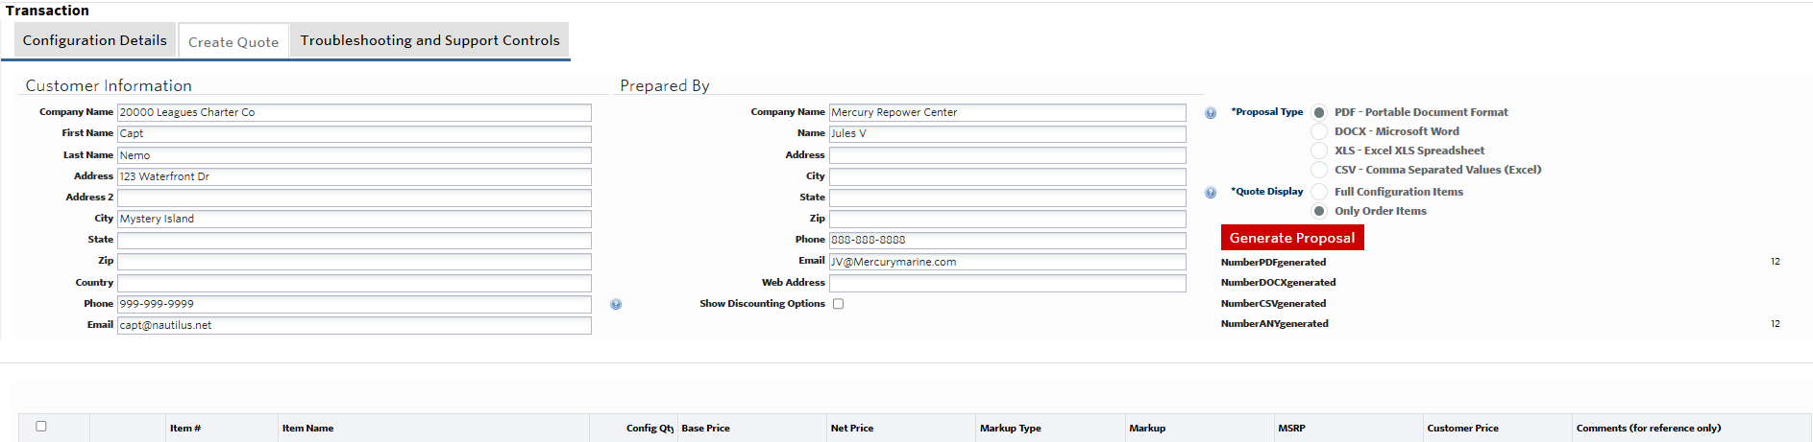
Quick Quote Proposal
You can select the file type you’d like to present to the customer with. PDF is recommended to share with a customer. An excel document would be helpful if you need to add to another system or worksheet you may use to manage quotes and leads.
On the create Quote Tab you will add customer contact information
As the quoter add your information and contact information
Click generate proposal
You can download or print this document to share the quote to your customer
*Remember only the MSRP and Customer Price columns will be shown on the quote document

Slide 21
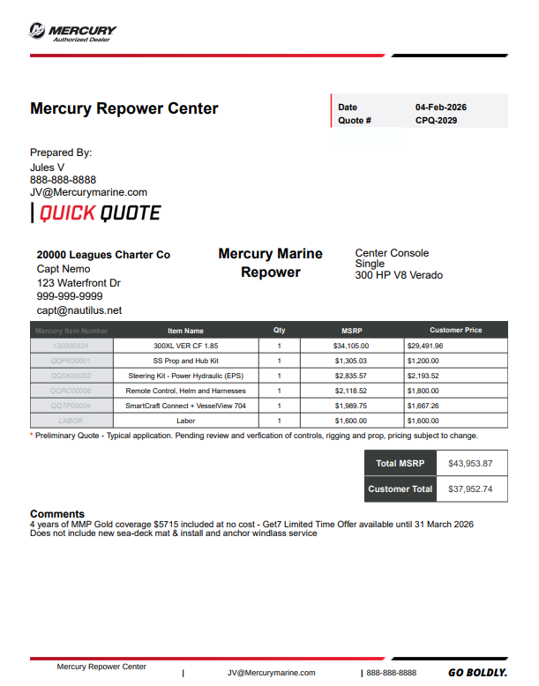
Quick Quote Proposal
Your Dealer Name will appear here
The contact information that was populated
Some of the application details selected on the configuration
Comments added to quote
Quick Quote is complete and ready for you to share with your customer

Slide 22
Quick Quote
Mobile Experience

Slide 23
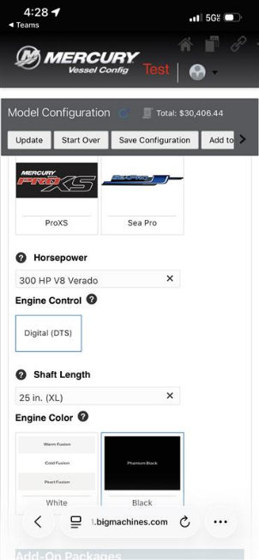
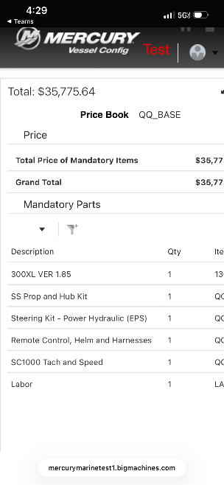
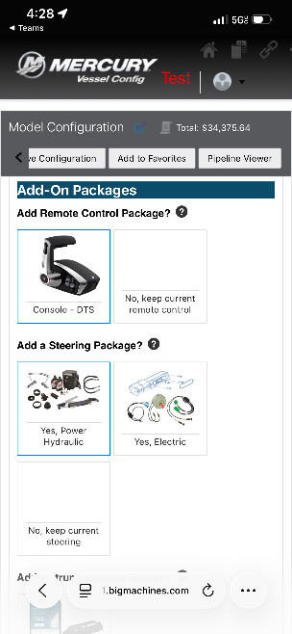
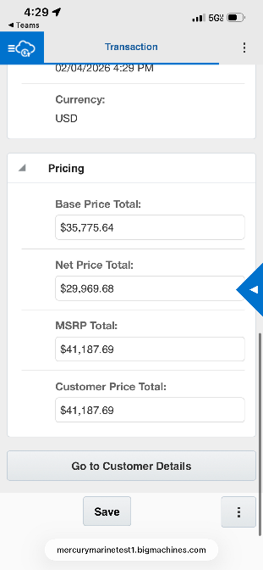
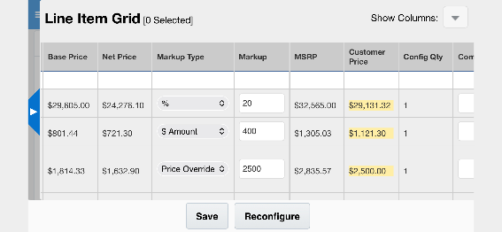
Quick Quote Mobile Experience
Through a web browser the same features and functionality is available on a mobile device or tablet
Configure
Quote
Scroll left-right or rotate from portrait to landscape orientation to see additional columns
Save Configuration Click the Blue Tab on the right screen edge to open the line-item grid with pricing and markup fields
Scroll left-right or rotate from portrait to landscape orientation to see additional columns

Slide 24
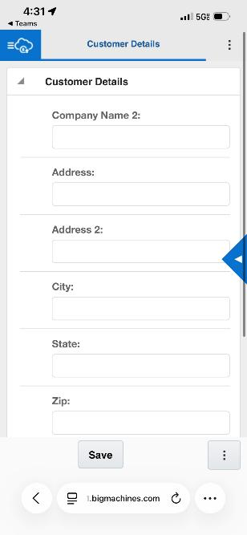
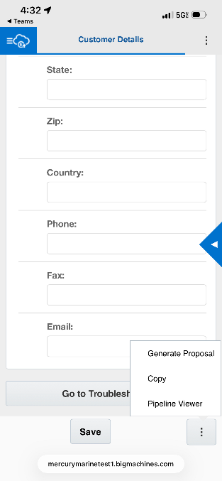
Quick Quote Mobile Experience
Through a web browser the same features and functionality is available on a mobile device or tablet
Scroll to bottom, update customer contact fields
Click the 3 stack button

Slide 25

Quick Quote
Appendix
Additional Reference Material

Slide 26
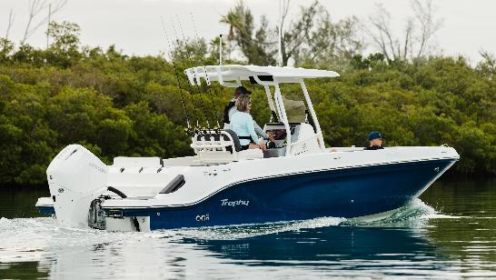


Quick Quote User guide reference
appendix
Demo Screen recording: Link
Economical V6 200 Center Console
Loaded V10 Center Console
Bass Boat 250 ProXS
Quick Quote Parts List Reference: Link
FAQ: Link

Slide 27


Thank you

