Slide 1
Quick Config Tutorial

Slide 2
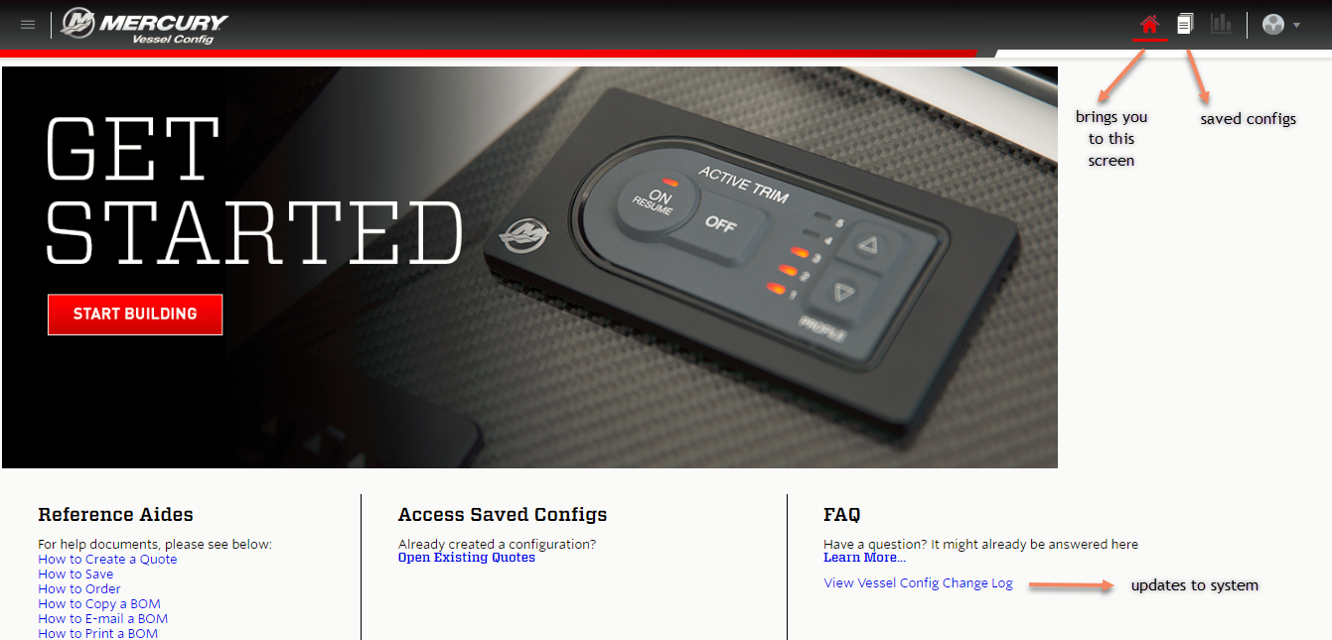

Slide 3
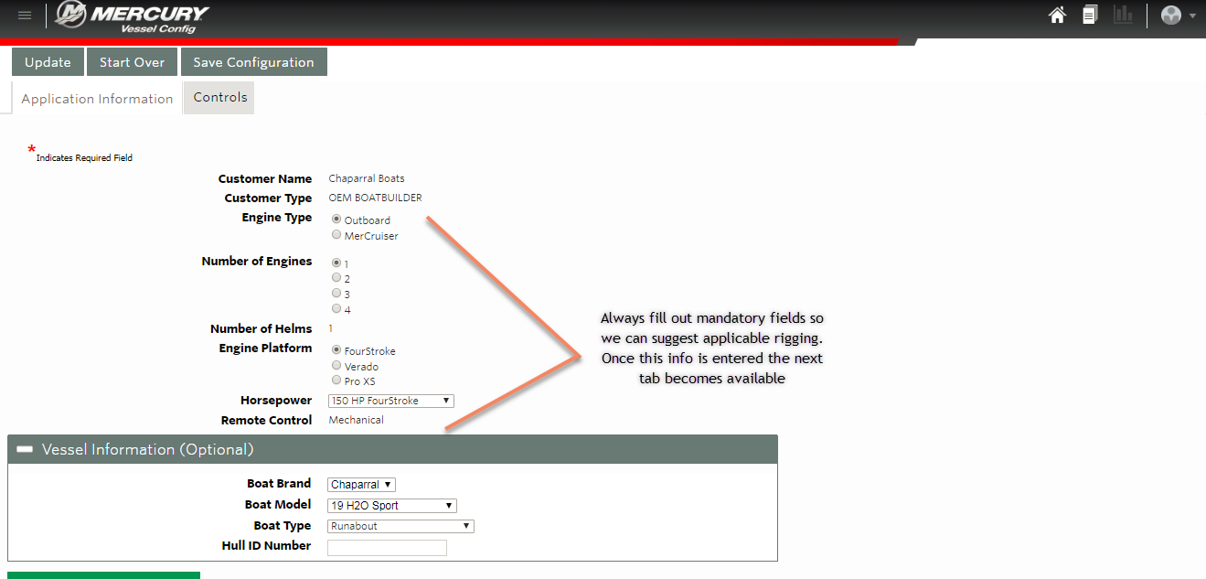

Slide 4
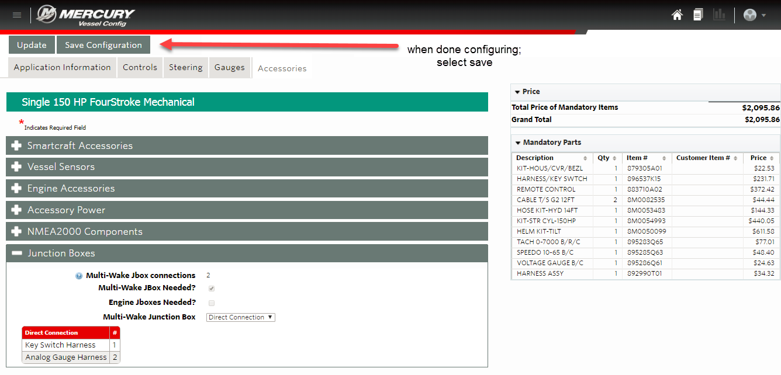

Slide 5
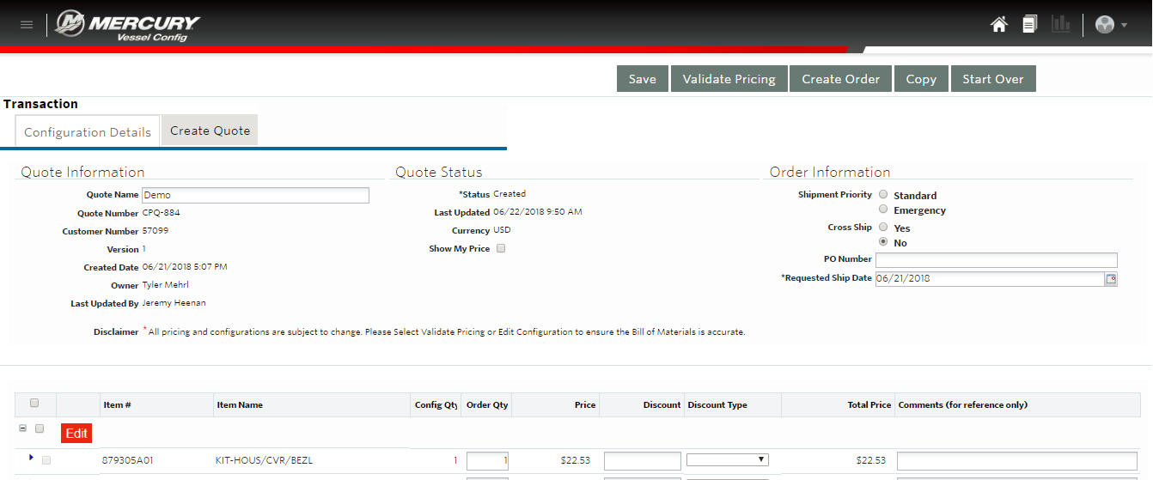
After selecting save you will be brought to this screen where you can name your configuration. You can also view your pricing or apply customer discounts. By clicking on the “Create Quote” tab you can also add customer information, export the BOM, or create a proposal document to give to the customer.

Slide 6
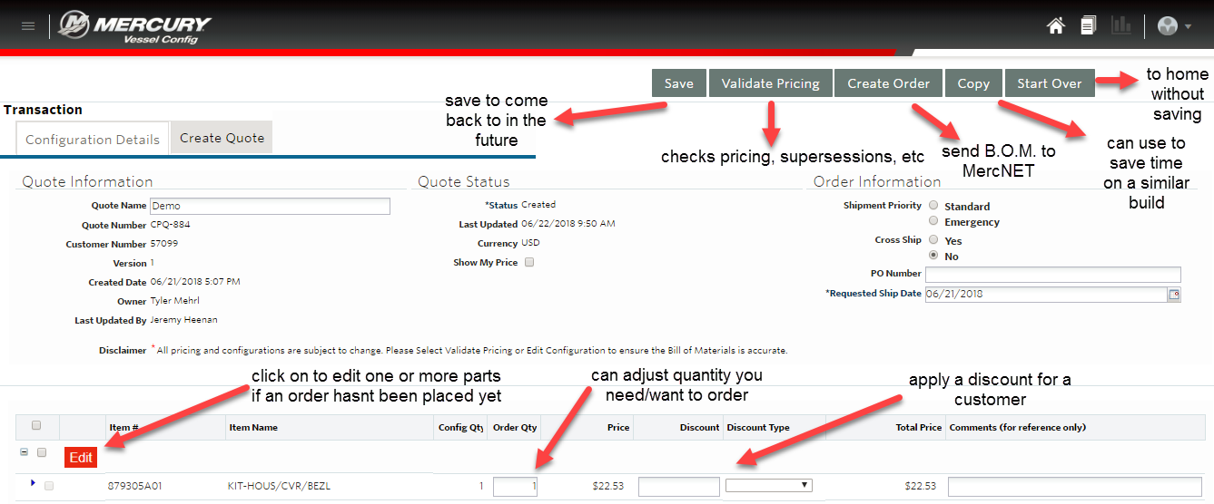

Slide 7
